Slide 1

.NET Aspire Hands-on
Bill Wolff
Agility Systems
Simpson Strong Tie
Microsoft MVP for 21 years
philly.NET Code Camp
April 19, 2024

Slide 2
Introduction
Brief Introduction to .NET Aspire
Open-source orchestration framework for cloud native apps
Why .NET Aspire?
Simplifies developer workflow and debugging
Timeline
Announced .NET Conf November 23
Now on Preview 5
Release in coming months, possibly //build conference
.NET Aspire documentation (Preview) | Microsoft Learn

Slide 3
What is .NET Aspire?
.NET Aspire as an opinionated, cloud-ready stack for building observable, production-ready, distributed applications
Delivered through a collection of NuGet packages that handle specific cloud-native concerns
Open source on GitHub

Slide 4
Key Features of .NET Aspire
Orchestration
Running and connecting multi-project applications and their dependencies
Components
NuGet packages for commonly used services, such as Redis or Postgres
Tooling
Project templates and tooling experiences for Visual Studio and the dotnet CLI
Deployment helpers for multiple cloud vendors

Slide 5
Orchestration in .NET Aspire
Explanation of orchestration in the context of cloud-native applications
How .NET Aspire streamlines the configuration and interconnection of different parts of your cloud-native app

Slide 6
.NET Aspire Components
Azure
Other Vendors
Kafka
OpenAI
Blob
Storage Queue
Table
SQL Server
SQL EF
CosmosDB
MongoDB
Key Vault
Service Bus
Oracle
MySQL
PostgreSQL
RabbitMQ
Redis

Slide 7
Aspire Tooling
Visual Studio 2022 Preview (VS Code supported also)
17.10.0 Preview 4.0
Command line
dotnet workload list
Aspire Samples
Or Podman
https://github.com/dotnet/aspire-samples
Docker Desktop

Slide 8
Project Types
.NET Aspire Starter Application
Blazor web app
Minimal API back end
Docker REDIS cache
Includes host and service
.NET Aspire Application
Includes host and service
.NET Aspire App Host
orchestrator
.NET Aspire Service Defaults
configuration

Slide 9
Project References
AppHost
ApiService
Web
ApiService
ServiceDefaults
Web
ServiceDefaults

Slide 10

AppHost Orchestrator
Build instance of IDistributedApplicationBuilder
Add resources:
AddProject
AddContainer
AddExecutable
Projects can reference other resources by name
Use API to add components

Slide 11
Running .NET Aspire
Set AppHost as the default project
Click F5 or Debug > Run
This opens the dashboard
Click the links for the ApiService and Web urls
Open Docker Desktop to see the active Redis container

Slide 12
Dashboard
Resources
Containers
Projects with endpoints
Monitoring
Logs
Structured Logs
Trace
Metrics
Theme support

Slide 13
Service Defaults
AddServiceDefaults() method in each project
<IsAspireSharedProject>true</IsAspireSharedProject> in csproj
ConfigureOpenTelemetry()
AddDefaultHealthChecks()
ConfigureClientDefaults
AddStandardResiliency()
UseServiceDiscovery()

Slide 14
Health Checks
GET /health
GET /alive
These also appear in the dashboard

Slide 15
Telemetry
Logging – baseline event logging
Tracing - correlates log events
Metrics – performance and health
Supports Open Telemetry protocol (OLTP)
QA or Production option to export telemetry
Azure Monitor
Promotheus

Slide 16
.NET Aspire Samples
AspireShop
AspireWithDapr
AspireWithJavaScript
AspireWithNode
ClientAppsIntegration
DatabaseContainers
DatabaseMigrations
Metrics
OrleansVoting
StandaloneDashboard
VolumeMount

Slide 17
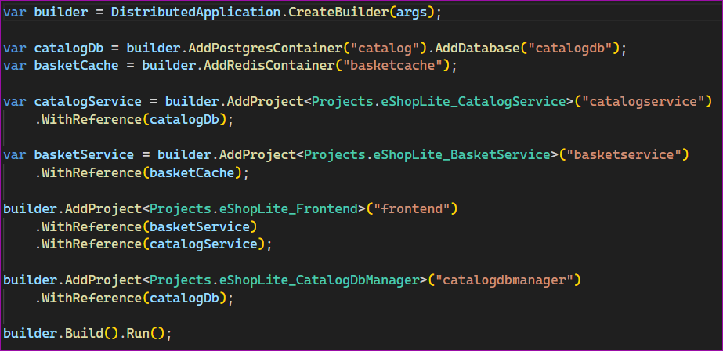
AspireShop
Purpose
Blazor e-commerce sample, gRPC access to cached cart, PostgreSQL db
Containers
catalog
basketcache
Projects
basketservice
frontend
catalogdbmanager

Slide 18
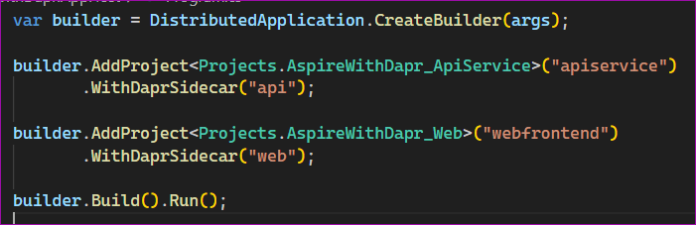
AspireWithDapr
Purpose
Integrate with dapr sidecar apps
Requires dapr install and init
winget install Dapr.CLI
dapr -h
Creates 3 containers
Projects
apiservice
webfrontend

Slide 19
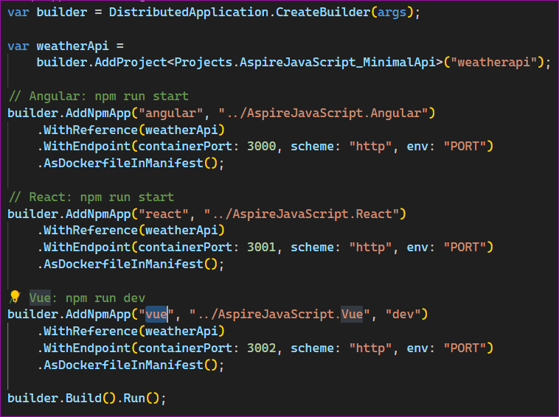
AspireWithJavaScript
Purpose
3 popular JS frameworks call same back-end API
Projects
weatherapi
angular
react
vue

Slide 20
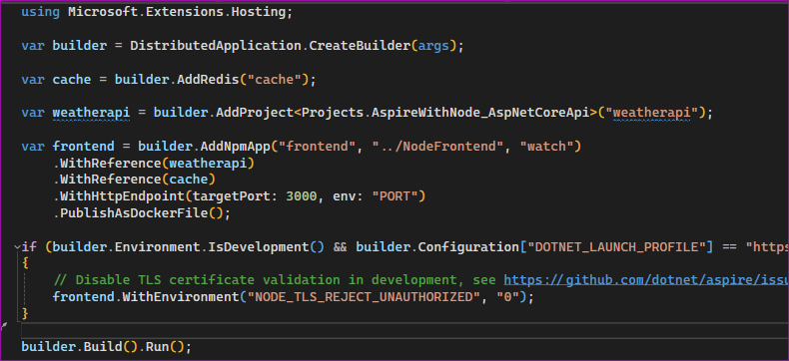
AspireWithNode
Purpose
Integrate node.js
Containers
cache
Projects
weatherapi
frontend

Slide 21
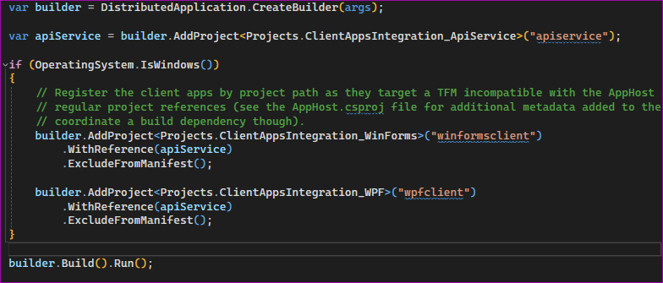
ClientAppsIntegration
Purpose
Integrate Windows Form and WPF desktop apps, demonstrate error logs
Projects
apiservice
winformsclient
wpfclient

Slide 22
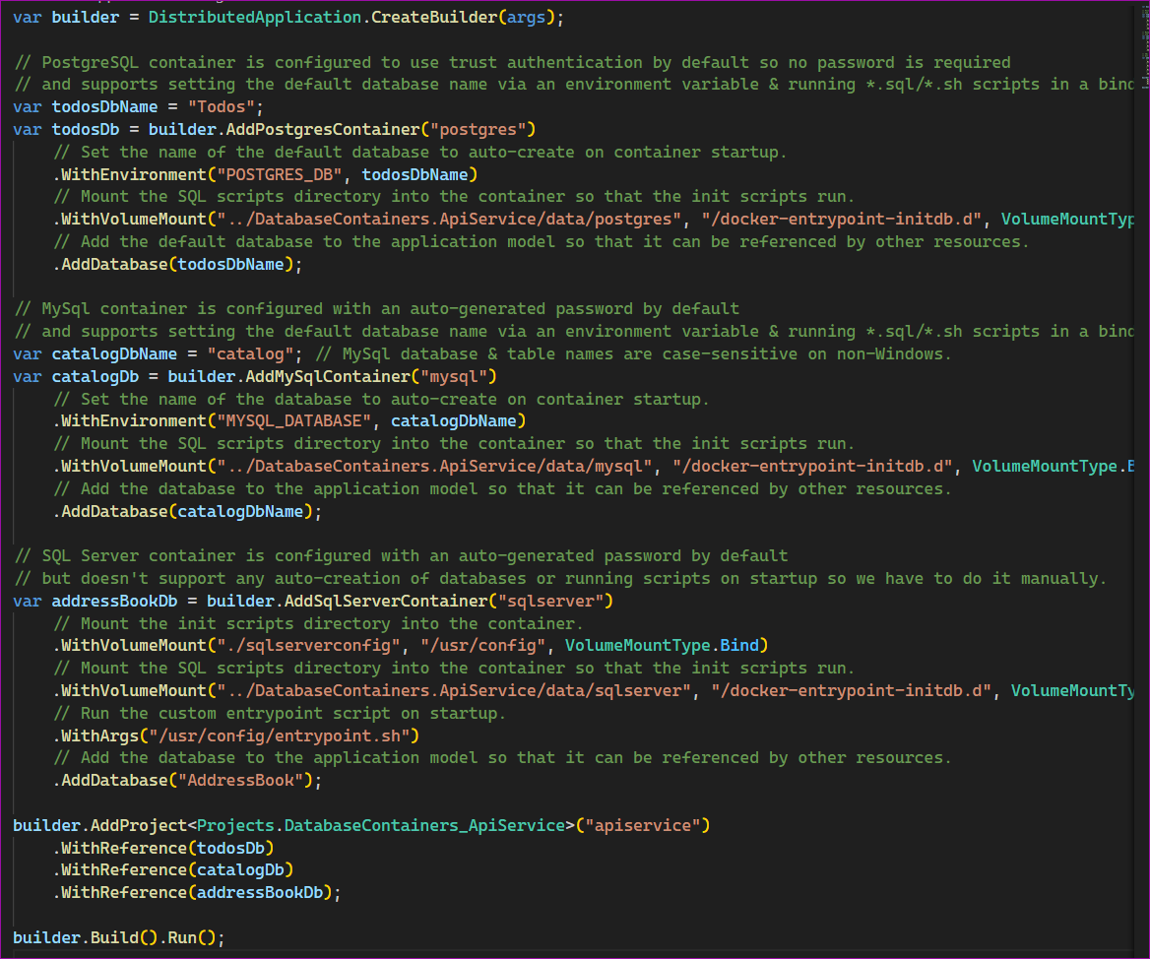
DatabaseContainers
Purpose
Api calls from 3 separate container databases, uses dapper ORM
Containers
postgres
mysql
sqlserver
Projects
apiservice
* show files in sqlserver

Slide 23
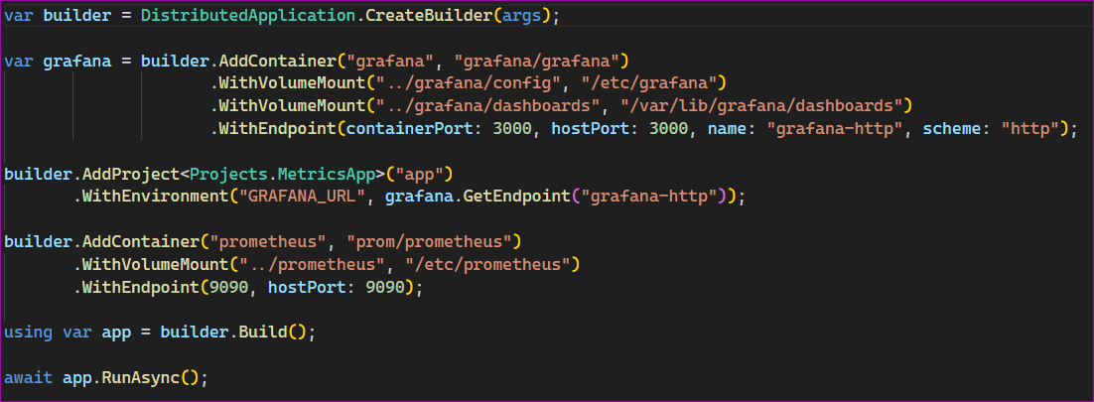
Metrics
Purpose
OpenTelemetry with Prometheus and Grafana
Containers
grafana
prometheus
Projects
app

Slide 24
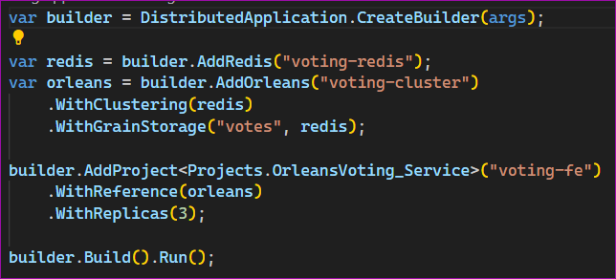
OrleansVoting
Purpose
Integrate Orleans
Containers
voting-redis
Projects (3)
voting-fe

Slide 25
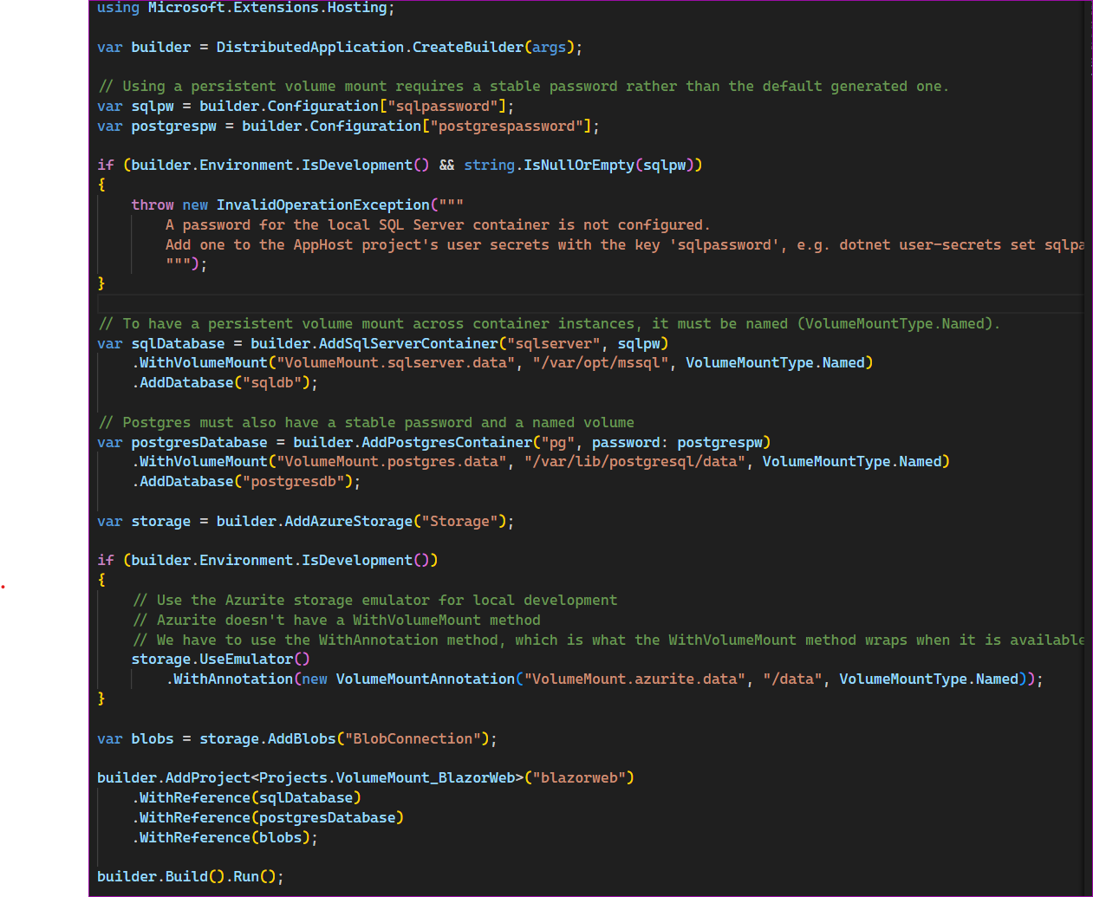
VolumeMount
Purpose
sqlserver container with persistent storage
Containers
sqlserver
pg
Storage
Storage
Projects
blazorweb

Slide 26

Conclusion
Recap of the key points
Future of .NET Aspire

